Slide 1






Rile Vince W. Soledad
Hezekiah C. Gatela
Computer
Science 2
The
Program
Start

Slide 2

Rile Vince W. Soledad
Hezekiah C. Gatela
Welcome!
to the Fresh Tracker! Team
Members:
Hezekiah C. Gatela (Interface, if statements)
Rile Vince W. Soledad (day logic)

Slide 3

Rile Vince W. Soledad
Hezekiah C. Gatela
Introduction / Problem Statement
Fresh Tracker!
– A Grocery and Expiry Date Management Tool
In many households, food and household products are often forgotten in storage until they expire,
leading to waste and unnecessary expenses. Likewise, grocery shopping can be unorganized, resulting
in overspending, buying duplicates, or forgetting essential items. Additionally, calculating expenses with
discounts, vouchers, and coupons can be confusing and time-consuming.
This project addresses the problem of product waste, poor grocery organization, and budgeting
challenges by creating a tool that helps users track expiry dates, manage grocery lists, and compute
costs effectively

Slide 4

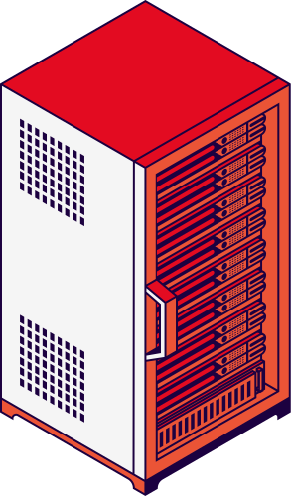
Rile Vince W. Soledad
Hezekiah C. Gatela
Our
Objectives
1. To provide a reminder system for expiry dates, reducing wasted food and money.
2. To organize grocery shopping through an interactive list where users can add, remove, and check
items.
3. To calculate total expenses including discounts, vouchers, and coupons for better budgeting.
4. To implement Python programming concepts (lists, conditional statements, functions, input/output).
5. To encourage responsible consumption and effective household management.

Slide 5


Rile Vince W. Soledad
Hezekiah C. Gatela
Our
Features
1. Expiry Tracker – Keeps track of items that are about to expire.
2. Grocery List – Add & Remove Items into your list.

Slide 6


Rile Vince W. Soledad
Hezekiah C. Gatela
Inputs and Outputs:
Inputs:
- Product name
- Expiry date (manual entry) OR product type (to assign estimated expiry)
- Grocery list items
- User choices (menu navigation)
Outputs:
- Alerts for expiring items (manual or estimated expiry)
- Organized grocery list (add & remove items)
- Confirmation messages (e.g., “Removed Soy Sauce!”)
- Closing message: “Thank you for using Fresh Tracker! May all your food BE FRESH!”

Slide 7

START PROGRAM
DISPLAY main menu
1 - Expiry Tracker
2 - Shopping List
3 - Exit
IF user chooses 1:
MOVE any expired items to expired list
DISPLAY fresh items with days remaining
DISPLAY expired items with days since expiry
DISPLAY options: Add Item, Remove Item, Back
IF user chooses Add Item:
ASK for product name and expiry date
IF user wants estimate and item is in library:
ASK if refrigerated, IF yes extend shelf life by 1.5x
CALCULATE and STORE expiry date = today + shelf life
IF no estimate or item not in library:
ASK user to enter date manually
STORE entered date
IF user chooses Remove Item:
ASK for item number and REMOVE from list
IF user chooses Back:
GO BACK to main menu
IF user chooses 2:
DISPLAY shopping list
DISPLAY options: Add Item, Remove Item, Clear List, Back
IF user chooses Add Item:
ASK for item name and ADD to list
IF user chooses Remove Item:
ASK for item number and REMOVE from list
IF user chooses Clear List:
CLEAR entire shopping list
IF user chooses Back:
GO BACK to main menu
IF user chooses 3:
DISPLAY exit message
END PROGRAM
Rile Vince W. Soledad
Hezekiah C. Gatela
Pseudocode
Get Started

Slide 8
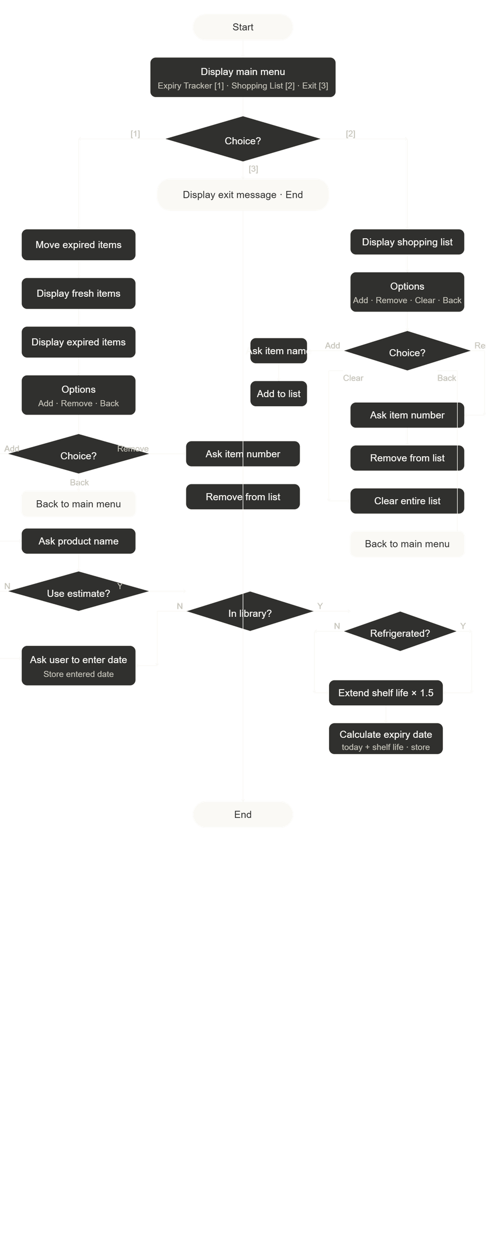

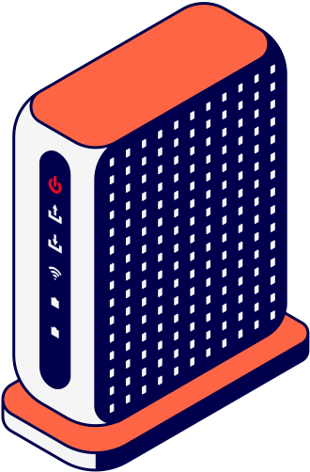
Flowchart
Rile Vince W. Soledad
Hezekiah C. Gatela

Slide 9
The
End

Slide 10
Rile Vince W. Soledad
Hezekiah C. Gatela
Thank You!
from the Fresh Tracker! Team
Members:
Hezekiah C. Gatela (Interface, if statements)
Rile Vince W. Soledad (day logic)
The
Program

